Slide 1
Affordable Care Act
Pub 4012 – Tab H
Pub 4491 – Lesson 3
Notes:
Release 2 changes
#10 Clarify SE health deduct out of scope when PTC is impacted
#43 Family includes only those shown on page 1 of 1040
#75 Changed to (paid SRP for all of 2017) replacing 2018
#84 Correct spelling to “they are” first bullet
This lesson is comprised of the following:
Intro
Intake Booklet
ACA Exemptions Overview
Marketplace Exemptions
Easy Exemptions
Affordability Exemptions: Comprehensive
Marketplace Exemptions
Shared Responsibility Payment: Comprehensive
Premium Tax Credit: Comprehensive
Quality Review
Learners should read through the ACA lesson in pub 4491 and be acquainted with the ACA content in Pub 4012 Tab H
Comprehensive material should be reserved for experienced Counselors

Slide 2
New for 2018
Shared responsibility payment (SRP) remains in place for 2018
SRP has been reduced to zero for years beginning after December 31, 2018
Fewer dependents are required to file due to larger standard deduction
Taxpayer's household income may be reduced
May result in higher PTC for taxpayer

Slide 3
New for 2018
Taxpayers can claim a coverage exemption for certain hardships on their returns
Previously, only the marketplace could grant these exemptions
The check box on Form 1040 can now be checked when the taxpayer, spouse if MFJ, and dependents (claimed or not) have either coverage or an exemption for every month of the year
Form 8965 is NOT required

Slide 4
Three Main Elements
Everyone should have health insurance (MEC)
If you don’t have health insurance, you should have an exemption
If you don’t have insurance or an exemption, you must pay a shared responsibility payment (SRP)

Slide 5
Fourth Element
There is a premium tax credit (PTC) for some people
If you buy insurance from the marketplace, and
Have AGI between 100% and 400% of federal poverty level
These are the two main criteria; other rules apply, discussed later

Slide 6
Intake Booklet

Slide 7
Intake Booklet and MEC Questions
Rely on interview and on taxpayer’s good faith representation
Did you and everyone on your return have health insurance coverage all year?
If not, make initial assessment of possible exemption(s)
May refer return to a more experienced Counselor
Notes:
We are not required to see Insurance cards, etc.
Emphasize to make lots of notes to document the taxpayer’s responses and for the reviewer
Emphasize for the reviewer to finalize the notes and conclusions on the intake form

Slide 8
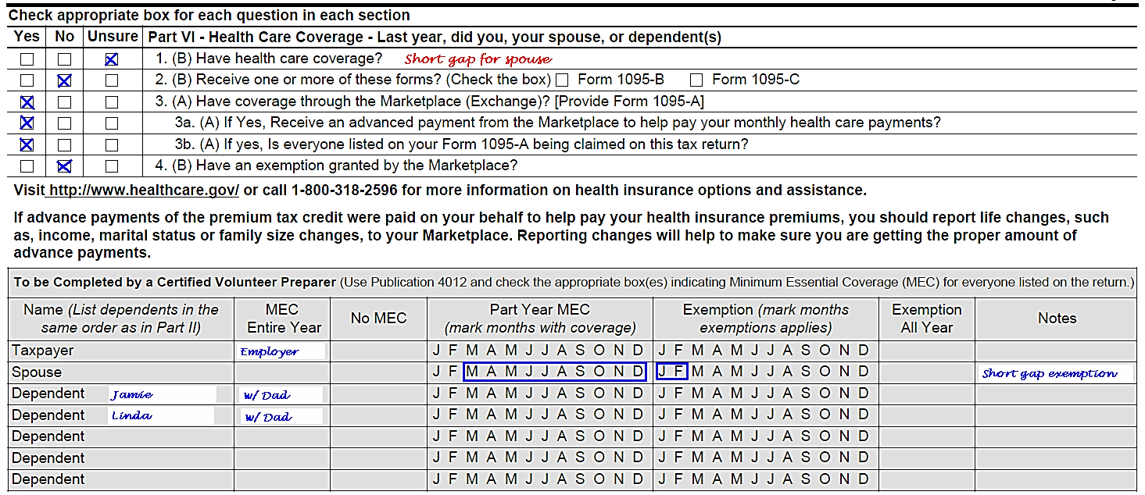
Intake Booklet
Preparer and Reviewer notations sample:
Complete the gray area every time!

Slide 9
Intake Booklet
If MEC purchased through the Marketplace, must have Form 1095-A
Should be received by 1/31/19
If a Marketplace exemption received, must have Exemption Certificate Number (ECN)
Notes:
1095-A filers have until January 31 to mail the form; it may take a few days for it to reach the taxpayer
Shared policies and alternative calculation discussed in day 2 lesson

Slide 10
Intake Booklet
Screen for out-of-scope issues with PTC
Self-employed health insurance deduction*
Shared policy
Alternative calculation for year of marriage with excess PTC
Code FF on Form W-2, box 12
* In scope if no impact on PTC
No PTC
No excess or additional PTC

Slide 11
Minimum Essential Coverage
MEC

Slide 12
Types of MEC
Employer-sponsored coverage (ESI)
Individual health coverage
Coverage under government-sponsored programs
Other coverage approved by Health and Human Services
Type of coverage important for exemption purposes
Notes:
It’s important to know the type of coverage for each individual for the affordability exemption (discussed later)
Foreign employer coverage is generally MEC
Emphasize that if ESI is taken, it is MEC and it doesn’t matter that it did not provide minimum value
Nonappropriated Fund Health Benefits Program of the Department of Defense program is both government-sponsored coverage and employer-sponsored coverage.

Slide 13
Individual Health Coverage
Can be purchased directly from insurance company
If purchased through the “Marketplace” or state “exchange,” it is a marketplace policy
Only marketplace policies are eligible for the premium tax credit
Coverage for one day means covered for the whole month
Notes:
Individual market insurance can be purchased directly from the insurance company or through an agency
The Health Insurance Marketplace offers many of the same policies that can be purchased directly

Slide 14
ACA Exemptions
Overview

Slide 15
ACA Exemption
ACA exemption is an exemption from the insurance requirement
Result: no shared responsibility payment

Slide 16
ACA Exemption
Exemption necessary when any individual on return lacks MEC for any full month
Which months?
Is there an easy exemption?
If not, should a more experienced counselor prepare the return?
Identify which exemption can be used before entering in TaxSlayer

Slide 17
Possible ACA Exemptions
Marketplace exemption certificate or application pending
Easy tax return exemption
Affordability exemption (two versions)
Hardship exemptions can now be claimed on the return

Slide 18
Exemptions Quick Reference Guide
Read Notes carefully – will say to whom the exemption applies (an individual or everyone on the return)
Note duration column – whole year or part year
Exempt for one day means exempt for the whole month!
Notes:
Pub 4012 Tab H

Slide 19
Marketplace Exemptions

Slide 20
Marketplace Exemption
Pub 4012 Tab H
Marketplace may exempt one or more individuals for some or all months of the year
Taxpayer provides their marketplace exemption certificate number (ECN) letter
If not yet received, use PENDING
Some marketplace exemptions can be for multiple years or a lifetime
If so, continue to use the same ECN
Taxpayer will know if they have a marketplace exemption

Slide 21
Easy Exemptions

Slide 22
Filing Threshold Exemption
Two filing threshold tests
One for taxpayer’s gross income
The other for household income
Does the taxpayer have income below the filing threshold?
Exemption applies to the entire household for the entire year.

Slide 23
Gross Income Below Filing Threshold
Pub 4012 Tab H
Tax return gross income below filing threshold
Does NOT include any dependent’s income
Notes:
Class should discuss what is in gross income and what is not

Slide 24
Gross Income Below Filing Threshold
Computed by TaxSlayer
Starts with total income on the tax return
Adds back expenses shown on Sch C
If splitting a joint business between taxpayer and spouse, do not inflate gross income artificially – such as entering the spouse’s share of income as revenue on their Schedule C and offsetting it with an expense on the taxpayer’s Schedule C
Adds back losses shown on F 8949 or Sch D
If grouped transactions, you need to separate gains from losses
Notes:
These are the in-scope adjustments
Out-of-scope adjustments would includes expenses shown on Sch E or Sch F
Emphasize to make the calculation after all other entries are in

Slide 25
Household Income Below Filing Threshold
Household income below filing threshold, where household income =
Include MAGI of claimed dependents whose gross income is above the gross income filing threshold
MAGI
Adjusted Gross Income (AGI)
Tax-Exempt Interest
Excluded Foreign Income
=
+
+
Notes:
We’ll refer to this as “Household Income A”
Highlight that there are various MAGI in the tax code

Slide 26
When to Add Dependents’ Income
Pub 4012 Tab H
Applies to a claimed dependent who is required to file due to gross income only
Enter amounts from returns of all claimed dependents if they have income over filing threshold
TIP: prepare dependents’ returns first!
Notes:
A dependent that needs to file to pay self-employment tax is not automatically included
The dependent’s gross income must exceed the filing threshold
A dependent’s income comes into play in several instances for ACA
Emphasize that for each and every instance, only when the dependent’s gross income exceeds the filing threshold
If the dependent is not in fact claimed, then do not include the dependent’s income in any instance

Slide 27
Filing Threshold Exemption
TaxSlayer computes if qualified for filing threshold exemption based on input
Everyone on the return is exempted for the whole year
Don’t need any other exemption and now don’t need Form 8965

Slide 28
Short-Gap in Coverage Exemption
Gap must be less than 3 consecutive months
Exemption does not apply if gap is 3 months or more
Look back (to 2017) but no need to look forward (to 2019)
If a month is covered by another exemption, it is treated as having coverage and that month is not a gap month
Notes:
Remember:
Coverage for one day = coverage for the full month
Exemption for one day = exemption for the full month

Slide 29
Short-Gap in Coverage Exemption
Can use short-gap exemption only once per individual per year
If two short gaps, short-gap exemption applies to earlier gap
Can use another exemption for another gap or for adjacent months

Slide 30
Short Gap Exemption Example 1
Taxpayer:
claimed the short-gap exemption for Dec 2017 only
had no coverage Jan 2018 (and no other exemption)
had coverage Feb – Nov 2018
had no coverage Dec 2018 (and no other exemption)
Can use short-gap exemption for Jan 2018 as the total short gap is less than 3 months (Nov 2017 had coverage or another exemption)
Cannot use the short-gap exemption for Dec 2018 (only one short-gap exemption per year)
Notes:
If 2 or more short gaps, short gap is used on the first such gap
If earlier gap is covered by another exemption, can use short-gap exemption for second gap

Slide 31
Short Gap Exemption Example 2
Hint: If short-gap exemption might apply for January 2018, check the 2017 return!
Taxpayer:
had no insurance Dec 2017 – Feb 2018
claimed short-gap exemption for Dec 2017
had coverage Mar – Dec 2018
Even though only 2 months of gap in 2017, cannot use short-gap exemption for Jan - Feb 2018 as total gap is 3 months or more
Notes:
If a different exemption was used for Dec 2016, then the short-gap exemption could be used for Jan/Feb 2016.

Slide 32
Short Gap Exemption Example 3
Taxpayer:
Had no insurance Jan – Jun 2018
Was incarcerated Jan – Apr 2018
Claim incarceration exemption for Jan – Apr (treated has having coverage)
Can claim short-gap exemption for May and June 2018
Notes:
Even if incarcerated for just one day, exemption is good for the month

Slide 33
Health Care Sharing Ministry Exemption
A Health Care Sharing Ministry is a tax-exempt organization acting as a clearinghouse for those who have medical expenses and those who desire to share those medical expenses
Taxpayer will know if they are a ministry member (or can call the ministry)
Exemption applies to months of ministry membership

Slide 34
Member of Indian Tribe Exemption
Member of a Federally-recognized Indian tribe, including
Alaska Native Claims Settlement Act (ANCSA) Corporation Shareholder (regional or village)
Otherwise eligible for services through an Indian health care provider or the Indian Health Service
Taxpayer will know if they qualify
Notes:
Taxpayer will know if this exemption applies

Slide 35
Incarceration Exemption
Includes being in a jail, prison, or similar penal institution or correctional facility after the disposition of charges
Does not include
Time in jail pending disposition of charges (being held but not convicted of a crime)
Time in probation, parole, or home confinement
One day of incarceration satisfies the test for the full month
Notes:
Includes juvenile hall detention

Slide 36
Noncitizens or Citizen Living Abroad Exemption
Most often seen scenario for this exemption code:
Not a U.S. citizen, not a U.S. national, and not lawfully present in the U.S.
Includes DACA immigrants
Notes:
Remind students that an ITIN does not necessarily mean that the individual is unlawfully present in the U.S.
DACA – Deferred Action for Childhood Arrivals – “Dream Act”
Allowed to stay in the U.S.
Still not lawful and eligible for the exemption

Slide 37
Noncitizens or Citizen Living Abroad Exemption
A nonresident alien, including
a dual-status alien in the first year of residency and
a nonresident alien or dual-status nonresident alien who elects to file a joint return with a spouse
Notes:
Does not apply if elect to be treated as a U.S. resident and meet certain presence requirements – Pub 519
Anyone who does not have an eligible immigration status as defined by the ACA
list of eligible statuses listed at: www.Healthcare.gov/immigrants/immigration-status

Slide 38
Noncitizens or Citizen Living Abroad Exemption
ITIN is not the same as unlawfully present
SS number is not the same as lawfully present
Example: DACA (dream act) individuals have SS numbers, but are not lawfully present
Need to ask status in the interview

Slide 39
Noncitizens or Citizen Living Abroad Exemption
Applies per individual
Applies to months of such status
Check the Exemption Reference Guide in NTTC-modified Pub 4012 for who is covered by the exemption and duration of exemption

Slide 40
Noncitizens or Citizen Living Abroad Exemption
Pub 4012 Tab H
Exemption applies also to:
A bona fide resident of a U.S. territory
A resident alien who was a citizen of a foreign country with which the U.S. has an income tax treaty with a nondiscrimination clause, and who was a bona fide resident of a foreign country for the tax year
A U.S. citizen or resident who spent at least 330 full days outside of the U.S. during a 12-month period
A U.S. citizen who is a bona fide resident of a foreign country or U.S. territory
Notes:
Remind students that an ITIN does not necessarily mean that the individual is unlawfully present in the U.S.
Unlikely that the second scenario will present itself at a Tax-Aide site

Slide 41
Noncitizens or Citizen Living Abroad Exemption
Greta lived in the U.S. the whole year but did not get her lawful status until June 15, 2018; her MEC started in August.
Is Greta eligible for an exemption?
Greta can claim the unlawfully present exemption for January through June and she can claim the short gap exemption for July
Notes:
Since unlawfully present exemption applies for at least one day in June, unlawfully present exemption applies Jan – June
For short-gap purposes, Jan – Jun are treated as having coverage; short gap starts Jul and is less than 3 months
It doesn’t matter what day in August Greta’s coverage started, one day means coverage for the full month

Slide 42
Adopted, Born or Died Exemption
Exempt for months of and before birth or adoption, or of and after death – examples:
Baby born in August 2018 needs to have coverage or an exemption starting September 2018
Dependent parent who died in January 2018 qualifies for the exemption for all months of 2018
Notes:
If 8965 is required to be filed, then need to list the part-year member and the months during which they were not a member (before birth or adoption or after death)
Remember that member needs coverage only for full months lived or months after the month of adoption

Slide 43
Medicaid Non-expansion State Exemption
At any time during 2018, resided (lived) in a state that did not expand Medicaid
Household income (adding only claimed dependents’ MAGI if they must file a return) is less than 138% of federal poverty line (FPL) based on household size (using individuals shown on Form 1040 page 1)
Notes:
Highlight if this applies to your state
These are the nonexpansion states for 2018: AL, FL, GA, ID, KS, ME, MO, MS, NC, NE, OK, SC, SD, TN, TX, UT, VA, WI, WY (UT has a ballot measure - Nov 2018 election)
Maine is new to the list for 2018

Slide 44
Medicaid Non-expansion State Exemption
Pub 4012 Tab H Worksheet
Household income includes
Untaxed SS refers to amount reported on SSA-1099 only
Includes the income of claimed dependents who have a filing requirement
Same MAGI as used for the Premium Tax Credit
Adjusted Gross Income (AGI)
Tax-Exempt Interest
Excluded Foreign Income
Untaxed Social Security Benefits
+
+
+
Notes:
We’ll refer to this as “Household Income B”
wholly-exempt SSI is not included

Slide 45
Medicaid Non-expansion State Exemption
Enter all income data and compute household MAGI
Can look at F8962 for MAGI
If household income is below 138% FPL, exemption applies for the full year for taxpayer and everyone listed on page 1 of Form 1040
Notes:
Household income includes taxpayer, spouse and household income of any claimed dependents required to file
138% FPL located in Pub 4012 Tab H
To generate 8962 when not otherwise needed, enter $1 as APTC on 1095-A input page

Slide 46
Medicaid Non-expansion State: Example
Mary files HoH with 2 dependent children. Mary’s AGI is $18,500
She and the children each received $2,000 in social security income during the year – none of the social security income was taxed
Mary lives in a non-expansion Medicaid state
Mary had no health insurance for the year but both children had CHIP
Does Mary qualify for the Medicaid non-expansion state exemption?

Slide 47
Medicaid Non-expansion State: Example
Yes
138% FPL amount for a household of 3 is $28,180 (2018)
Mary’s household income is $20,500:
$18,500 AGI + $2,000 untaxed social security
Children’s untaxed social security income not included because they are not required to file
Notes:
If Mary’s income was $18,000 or less, she would not need this exemption. Why? Not required to file – automatic exemption

Slide 48
General Hardship Exemption
Applies to the month before, the months of, and the month after a hardship
Hardships include: homelessness, eviction or facing eviction, receiving utility shut notice, domestic violence, death of a close family member, fire/ flood/ other natural or human-caused disaster, bankruptcy, and others
See the complete list in Instructions to Form 8965 or NTTC-modified Pub 4012

Slide 49
General Hardship Exemption
Previously was granted by the Marketplace only
New for 2018, can be claimed on the return
Include in Form 8965 when the form is required to be filed

Slide 50
Exemptions in TaxSlayer
Pub 4012 Tab H
Form 8965 Health Coverage Exemptions
Required when a household members lacks health coverage and no exemption applies for one or more months
Refer to Pub 4012 Tab H for software entries

Slide 51
Affordability Exemptions
Comprehensive

Slide 52
Affordability Exemption
Cheapest available insurance costs more than the affordability threshold
8.05% of household income for 2018
TaxSlayer supports parts (but not all) of the affordability exemption
Be sure all exemptions are properly claimed when F8965 is required to be filed
Notes:
Do not confuse the two different affordability thresholds!
2018 Affordability threshold for Affordability Exemption eligibility 8.05%
2018 Affordability threshold for PTC eligibility 9.56% - discussed later

Slide 53
Affordability Exemption
Two affordability tests:
With an offer of employer coverage
Without an offer of employer coverage
Both test the applicable cost against the affordability threshold
If coverage is unaffordable for the month, the exemption applies for the month
Notes:
Each will be discussed
If there is an offer of ESI (employer sponsored insurance), test that ONLY

Slide 54
Affordability Threshold for Exemption
Taxpayer’s household income plus pre-tax medical, including MAGI of claimed dependents who must file a return based on gross income
Multiplied by 8.05% for 2018
Adjusted Gross Income
(AGI)
Tax-Exempt Interest
Excluded Foreign Income
Pre-tax medical, if any
+
+
+
Paycheck Stub
Untaxed social security is not included
Notes:
The same affordability threshold is used for both the marketplace affordability test and for the employer offer affordability test

Slide 55
Affordability Exemption in TaxSlayer
Can use TaxSlayer affordability for simple situations
Enter pre-tax medical amount, if any
Follow instructions for employer offer
If no employer offer, carefully follow instructions for Line 1 and Line 10 of Marketplace Coverage Affordability (MCA) worksheet

Slide 56
Bogart Affordability Calculator
Use for more complicated situations
E.g. mixture of employer offer and no employer offer for different members of the household; unclaimed dependent;
URL is cotaxaide.org/tools
Includes a training video
Read all line instructions carefully
Great tool – if used properly

Slide 57
Affordability Exemption: Employer Self-Only Offer
Pub 4012 Tab H
Offer of employer coverage for the employee
Does the lowest-cost self-only plan offered by the employer cost more than the affordability threshold?
The offer may be reported on Form 1095-C, if available
Exemption is applied monthly (eligibility or cost of employer’s offer may change during the year)
Notes:
An offer of COBRA or retiree coverage is not an offer unless accepted (in which case, the former employee has MEC)

Slide 58
Affordability Exemption: Employer Family Offer
Offer of employer coverage for the employee's family (the offer includes the employee)
Does the lowest-cost plan that covers everyone in the tax household who is eligible for coverage and is not otherwise exempt cost more than the affordability threshold?
Include an individual that is also eligible for other coverage, e.g. Medicare or CHIP
Do not include an individual with an exemption, such as health care sharing ministry
Do not include an unclaimed dependent (they have their own MAGI and affordability test)
Notes:
It does not matter that a member of the family is eligible for other coverage, such as government-sponsored insurance (e.g. CHIP)
The offer includes the cost for the employee (that is, the quote is for the employee and family)

Slide 59
Affordability Exemption: Employer Family Offer
Use the fewest number of policies needed (may be more than one)
Exemption applies monthly for each member of the family – excluding the employee
Employee must use self-only offer test
Notes:
It does not matter that a member of the family is eligible for other coverage, such as government-sponsored insurance (e.g. CHIP)
The offer includes the cost for the employee (that is, the quote is for the employee and family)
Multiple policies needed:
An employer might offer the spouse coverage on a separate policy, not as part of the family coverage
Might also be the case for a dependent child over the age of 26
Might also be the case for a same-sex spouse
Note: do not include anyone who is not on the taxpayer’s return, such as an unmarried partner who files their own return

Slide 60
Affordability Exemption: Aggregate Employer Offer
Two or more members of the family have offers of employer coverage
Are all of the following true:
Each individual offer of coverage is less than the affordability threshold,
But their combined cost is greater than the affordability threshold,
And no family coverage is offered for less than the affordability threshold
Notes:
The members do not have to be the taxpayer and spouse
It could be any member whose employer offered at least self-only coverage
Exemption can be claimed even if one member takes their self-only offer

Slide 61
Affordability Exemption: Aggregate Employer Offer Example
Exemption applies to everyone all year
Example: MAGI = $50,000
Affordability threshold 8.05% = $4,025
Taxpayer’s self-only ESI offer: $300/mo or $3,600/yr
Spouse’s self-only ESI offer: $289/mo or $3,468/yr
Combined ESI offer: $589/mo or $7,068/yr
Taxpayer’s family ESI offer: $604/mo or $7,248/yr (or no offer of family coverage)
Affordable
Affordable
Not Affordable
Not Affordable
Notes:
Exemption would also apply if there is no offer of family coverage
The test is whether there is an affordable offer of family coverage

Slide 62
Affordability Exemption: Aggregate Employer Offer
When exemption applies in any month, it applies for the entire year for all individuals on the return
Even if one member takes their self-only coverage, the other members can claim this exemption if the tests are met
Notes:
The members do not have to be the taxpayer and spouse

Slide 63
Affordability Exemption
Comprehensive
No Employer Offer

Slide 64
Affordability Exemption: No Employer Offer
Pub 4012 Tab H
Does the net cost of the lowest-cost bronze plan (LCBP) cost more than the affordability threshold?
After any PTC that the taxpayer would have been eligible to receive
This is a hypothetical calculation for the exemption only
Need to look up plan costs for individual ages and zip codes
Will need to look up quotes again if zip code changes
Notes:
The LCBP may be a HSA plan and that’s ok
An HSA plan has been crafted to meet the high deductible rules, but it is still MEC

Slide 65
Affordability Exemption: No Employer Offer Example
Papa and Nana are on Medicare, grandchild age 20 uninsured and ineligible for Medicaid
MFJ ages 69, 67 (beg. of yr) Collier County, FL 34110
Dependent grandchild age 20 (beg of yr)
Retirement income | $30,000
Total Social Security | 20,000
Medicare costs | 2,578
Grandchild’s MAGI | 7,777
Household income | 41,777
(Social Security income not included for test)
Notes:
Assume that grandchild is not eligible for CHIP or Medicaid

Slide 66
Affordability Exemption: No Employer Offer
Pub 4012 tab H
Line 1 – lowest cost bronze plan (LCBP) for persons that are not eligible for employer coverage and not otherwise exempt
INCLUDES family members that have or are eligible for government-sponsored coverage
e.g. Medicare, Medicaid, CHIP, VA or TRICARE
Use sum of fewest number of bronze plans possible if one policy cannot cover all persons
Notes:
Active military personnel are covered by TRICARE
Government employees are covered by an employer-sponsored plan, not a government-sponsored plan
Although state exchanges may have a different result, may not be able to get one policy that covers TP/SP and unrelated qualifying relative; the unrelated qualifying relative may need a separate quote for both Lines 1 and 10; the test will use the sum of the policy quotes

Slide 67
Affordability Exemption: No Employer Offer
Look up LCBP for Line 1
Both grandparents and the grandchild
Notes:
MCA = Marketplace Coverage Affordability
LCBP = lowest cost bronze plan

Slide 68
Affordability Exemption: No Employer Offer
Pub 4012 Tab ACA
Line 10 – SLCSP* cost for persons that can get insurance only in the individual market and not otherwise exempt
EXCLUDES family members that have or are eligible for government-sponsored coverage
e.g. Medicare, Medicaid, CHIP, VA or TRICARE
Use sum of fewest number of silver plans possible if one policy cannot cover all persons
*Second-lowest-cost silver plan
Notes:
You may need to determine whether an individual is actually eligible for Medicaid.
Ask the taxpayer or look on Medicaid.gov for your state and county as income limits may be higher than 138%, especially for children under age 19 or pregnant women
Generally for Expansion states:
When the household MAGI (increased for untaxed social security benefits) is above 138% of the federal poverty line, the tax family is not eligible for Medicaid and is eligible for a PTC. Line 10 SLCSP will include all the individuals that do not have an employer offer.
When the household MAGI (increased for untaxed social security benefits) is below 138%, the tax family would have been eligible for Medicaid and not eligible for PTC. In this case, Line 10 SLCSP will be zero.
Generally for Non-expansion states:
When the household MAGI (increased for untaxed social security benefits) is above 100% of the federal poverty line, the tax family is not eligible for Medicaid and is eligible for a PTC. Line 10 SLCSP will include all the individuals that do not have an employer offer.
When the household MAGI (increased for untaxed social security benefits) is below 100% of the federal poverty line, the tax family would have been eligible for Medicaid and would therefore not be eligible for the PTC. In this case, Line 10 SLCSP will be zero.
Tip: When the household MAGI (increased for untaxed social security benefits) is 0% to 138% of FPL and the tax family lived in a non-expansion state during any part of the year and did not have minimum essential coverage, use code G exemption for the whole year – the affordability calculation/exemption is not needed.

Slide 69
Affordability Exemption: No Employer Offer
Look up and enter SLCSP on Line 10:
Grandchild only!
Individuals included in Line 10 can be different than those in Line 1!

Slide 70
Affordability Exemption: No Employer Offer
Complete lines 11, 12 and 13
Compare to affordability threshold of 8.05% of $41,777 or $3,363
Notes:
Exemption met for all months in this example
Remind class that affordability threshold (slide 71) does not include untaxed social security, but would include pre-tax medical

Slide 71
Affordability Exemption: No Employer Offer
When annualized cost (line 13 of MCA Worksheet) is greater than affordability threshold
Exemption applies to those included in line 1 that need the exemption
Notes:
Exemption met for all months in this example

Slide 72
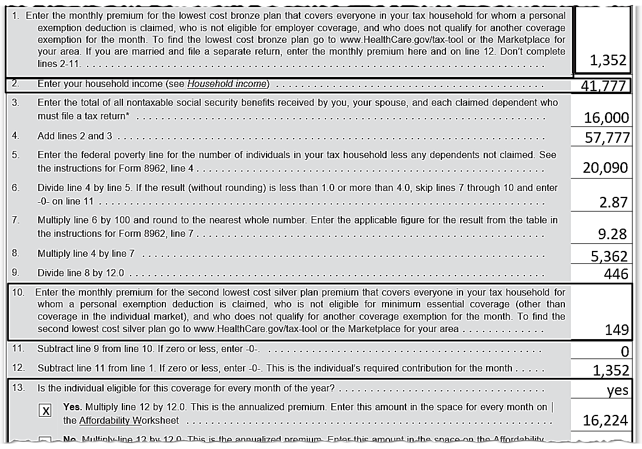
Affordability Exemption: No Employer Offer
Grandchild can claim the exemption; grandparents don’t need an exemption
Notes:
This is the full worksheet

Slide 73
Affordability Exemption – Unclaimed Dependent
Add unclaimed dependents to the tax return for health insurance purposes only
Virtually all will qualify for an exemption
Unclaimed dependent has their own, separate household income (do not combine with taxpayer)
Enter that exemption when Form 8965 is required
Cannot use TaxSlayer affordability calculator

Slide 74
Unclaimed Dependent has OWN MAGI
For the non-expansion state exemption (AGI under 138% FPL)
For either filing threshold exemption
Gross income or MAGI is less than their filing requirement
Use “Affordability Exemption” code in TaxSlayer
For employer offer affordability exemption
For no employer offer affordability exemption
Lowest cost bronze plan > 8.05% of AGI
As a dependent, even though unclaimed, not eligible for PTC

Slide 75
Affordability Example: Tommy
Tommy, age 27 on 1/1/2018, lives in an expansion state, no coverage all year (paid SRP for all of 2017)
Worked Jan and earned $2,000
Employer offered coverage at $95/ mo
Unemployed Feb – Oct and got $8,200 of unemployment income
Eligible for Medicaid, but did not apply
Worked Nov – Dec and earned $5,000
Employer coverage starts Jan 2019
MAGI = $15,200

Slide 76
Affordability Example: Tommy
No Marketplace exemption
Above the filing threshold
A citizen of the U.S.; not in a health care sharing ministry; not a member of an Indian tribe; not incarcerated; and no general hardship
Only possible exemptions
Short gap
Affordability

Slide 77
Affordability Example: Tommy
Preliminary assessment:
Affordability for Jan – measured against employer offer (Tommy may have brought in a 1095-C with the information or he otherwise said how much it would have cost him)
Affordability for Feb – Oct measured against LCBP with no PTC because Tommy was eligible for Medicaid; LCBP is $175 / mo
Affordability for Nov – Dec measured against LCBP net of PTC (not eligible for Medicaid with new job); LCBP is $175 / mo, SLCSP is $226 / mo
Notes:
Medicaid eligibility may have a 45-day waiting period before eligibility – for this example, assumed that Medicaid eligibility started in February (could have lost his job early Jan)
Medicaid eligibility may really continue until the next evaluation date
For purposes of this example, it is assumed that Tommy was not eligible for Medicaid at all in November and December

Slide 78
Affordability Example: Tommy
Compute Tommy’s affordability threshold: $15,200 X 8.05% = $1,224
Jan – employer offer $95 x 12 = $1,140
Employer offer was affordable for January
Notes:
Emphasize to always use annual amounts

Slide 79
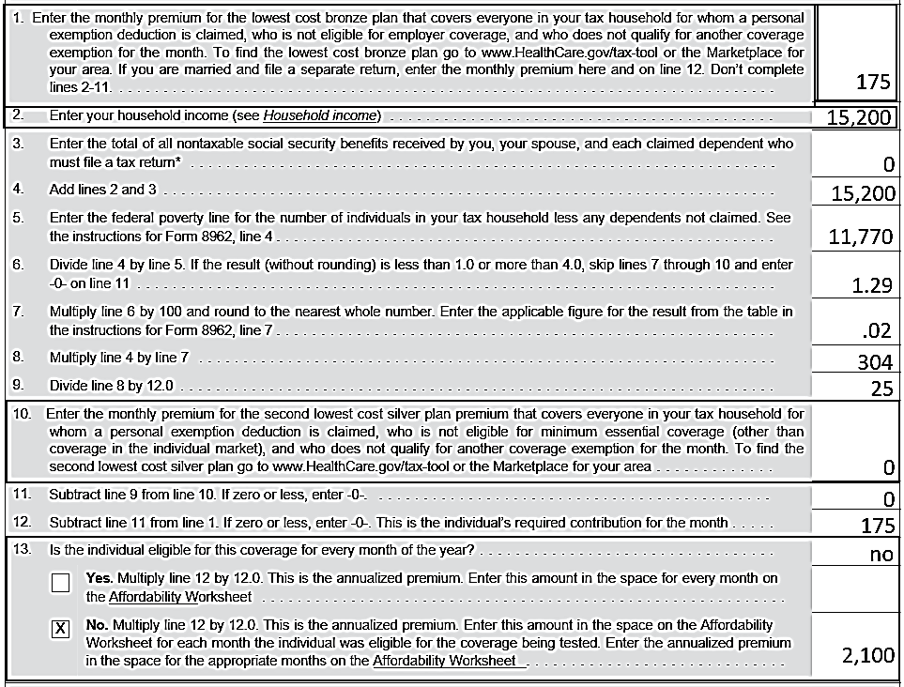
MCA Wkt for Tommy: Feb - Oct
L 1: LCBP
Tommy was eligible for Medicaid
Line 10: no SLCSP
Line 11: No PTC

Slide 80
Affordability Example: Tommy
Feb - Oct – MCA worksheet $2,100
Compare to Tommy’s affordability threshold: $15,200 X 8.05% = $1,224
Marketplace coverage was unaffordable for Feb - Oct
Notes:
Emphasize to always use annual amounts

Slide 81
Result for Tommy
January – affordable employer offer, look back to 2017 and gap is 3 months or more so cannot claim short-gap (SRP is owed)
Feb – Oct – marketplace coverage was not affordable – get the exemption
Nov – Dec – 1st gap of the year of less than 3 months so can get the short gap exemption
Notes:
Highlight that prior November and December were gap months as no coverage and no exemption.

Slide 82
Marketplace Exemptions

Slide 83
Marketplace Exemptions
Pub 4012 Tab H
Now limited to
Members of certain religious sects
Ineligible for Medicaid based on a state’ nonexpansion
Coverage considered unaffordable based on projected income
Certain Medicaid programs that are not MEC

Slide 84
Marketplace Exemption
Prior year Marketplace exemptions may be for several years or for a lifetime – they are effective unless the circumstance have changed
For example, no longer member of the exempted religious sect
Exemption application forms:
Marketplace.cms.gov
For Connecticut only:
www.accesshealthct.com/AHCT/jsp/frontend/feiam/IndividualExemptionApplication.pdf

Slide 85
Filing a Return to claim a Coverage Exemption
If Randy is not required to file a federal income tax return, does he need to file to claim an ACA exemption?
Randy does not need to file just to claim the ACA exemption. If he files a return anyway, he can check the box (coverage or exemption the full year)

Slide 86
Shared Responsibility Payments
Comprehensive

Slide 87
Three Main Elements
Everyone should have health insurance (MEC)
If you don’t have health insurance, you should have an exemption
If you don’t have insurance or an exemption, you must pay a shared responsibility payment (SRP)

Slide 88
Shared Responsibility Payment
Greater of
2.5% of household income over filing threshold or
$695/adult ($342.50/child)
TaxSlayer does calculations

Slide 89
Household Income for SRP
Taxpayer’s MAGI (including spouse if MFJ)
MAGI does NOT include untaxed Social Security
Add claimed dependent’s MAGI – if dependent is required to file a return due to gross income
Do not add anyone else’s MAGI, e.g. unclaimed dependent or spouse when filing MFS

Slide 90
Shared Responsibility Payment
If all months accounted for with coverage or exemption, no SRP
If not, TaxSlayer computes SRP

Slide 91
Premium Tax Credit
Comprehensive

Slide 92
Premium Tax Credit
Premium Tax Credit (PTC) – a refundable credit
Marketplace estimates PTC at time of purchase
PTC can be paid in advance (APTC) to insurance company or applied as refundable credit on federal tax return
Notes:
Form 1095-A Affordable Insurance Marketplace Statement shows the amount of their premiums and advance credit payments including the premium for the applicable benchmark plans used to compute the credit, the total premium for the coverage of the taxpayer, the advance credit, the SSN and names of all covered and other relevant information.
Form 8962 is used to compute the premium tax credit on the tax return and to reconcile the advance credit payments or credit.

Slide 93
Premium Tax Credit
Taxpayers who get APTC must file tax returns and reconcile their APTC
If they don’t, e.g. failed to file for 2017, may lose APTC in 2019
Up to the Marketplace
Encourage taxpayers to file all returns as required

Slide 94
PTC Eligibility
If marketplace has granted APTC, persons listed on Form 1095-A are eligible for PTC
We do not second guess!
We compute the final amount of PTC based on the final 2018 income
Notes:
Employee safe harbor rule –
Mkt determines that employer plan is unaffordable
Even if the employer plan turns out to be affordable based on actual household income, employee remains eligible for PTC
If affordable all of the second year, loses the safe harbor

Slide 95
PTC Eligibility
For the year:
Household income within 100% to <401% of FPL
Cannot be claimed as a dependent
Cannot file MFS
Exceptions apply
Notes:
The Marketplace will make the eligibility determination. Taxpayer is responsible for keeping Mkt up to date.

Slide 96
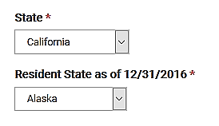
FPL in Alaska or Hawaii
If taxpayer or spouse lived in Alaska or Hawaii at all during 2018
Use higher FPL
Enter Alaska or Hawaii as resident state field on Personal Information screen

Slide 97
PTC Eligibility: Less than 100% of FPL
FPL less than 100% normally means not eligible for PTC
Exceptions (that is, still eligible for PTC)
Marketplace granted APTC
If no APTC, exception does not apply - do not input 1095-A into TaxSlayer
Lawfully present alien ineligible for Medicaid
Example, first 5 years
Notes:
Emphasize: 400.999% is less than 401% - TaxSlayer handles properly.
If 1095-A is input, TaxSlayer automatically computes PTC and applies the cap

Slide 98
PTC Eligibility – More Requirements
For the month:
Must have qualified health plan* through Marketplace as of the first day of each month
TP’s share of premiums paid by due date of return
Not eligible for other MEC
Exceptions apply
* Catastrophic plans are MEC but are not eligible for PTC
Notes:
The Marketplace will make the eligibility determination. Taxpayer is responsible for keeping Mkt up to date.
First day of month coverage requirement is met by a child born, adopted or placed in the home for adoption or foster care during the month.

Slide 99
PTC Eligibility – Not Eligible for Other MEC
Pub 974
Normally, cannot claim PTC if eligible for government-sponsored or affordable* employer coverage, whether or not enrolled
Except for (can get PTC)
Transition month(s) when moving from one coverage to another
Retroactive coverage (e.g. retro Medicaid)
COBRA or retiree coverage not taken
Government-sponsored coverage in some cases (see Pub 974)
* Affordability rate of 9.56% for PTC used by Mkt (higher than exemption affordability rate of 8.05%)
Notes:
• May be exhibited on Form 1095-A and Form 1095-B or 1095-C with data for the same month(s
The forms may not be received until the end of March – IRS extended the due date
2018 Affordability threshold for PTC eligibility 9.56%
2018 Affordability threshold for Affordability Exemption eligibility 8.05%

Slide 100
PTC Eligibility – Not Eligible for Other MEC
Can qualify for PTC even though covered by
Limited coverage Medicaid
AmeriCorps or AfterCorps (for returning Peace Corps)
Other coverage that is not MEC
Note: employer coverage that is unaffordable or does not provide minimum value but is taken anyway is considered MEC for PTC purposes
Notes:
Limited benefits coverage is generally not treated as MEC
There are exceptions – rely on the Mkt for determination of PTC eligibility

Slide 101
PTC Eligibility – Family Glitch
Pub 974
An employee’s tax family member is ineligible for PTCs if member is offered employer-sponsored coverage (ESI) and self-only coverage is affordable – example:
Employee coverage is affordable, so children in the tax family are ineligible for PTC
If no spousal ESI offer, spouse is eligible for PTC
Employee-only offer at 6% of income
Employee and children offer at 10% of income
Notes:
If there is no offer of coverage, e.g. no spousal coverage offer, then the affordability test does not apply to the spouse
If the family member is not claimed as a spouse or dependent on the employee’s tax return, the offer of ESI does not make the individual ineligible for PTCs – the family member must be a TAX family member
“No spousal ESI offer” means family offer is for employee and children only - No employee, spouse and children offer.

Slide 102
PTC Eligibility – Cannot File MFS
Exceptions
Abused spouse living apart from spouse and cannot file jointly due to abuse
Abandoned spouse unable to locate spouse after due diligence
HoH is not MFS and is eligible for PTC
Notes:
See exceptions for MFS in Pub 8962 instructions for victims of domestic abuse or spousal abandonment See pub 974 for documentation that the taxpayer should retain

Slide 103
PTC Eligibility - QSEHRA
Qualified small employer health reimbursement arrangements (QSEHRAs) reimburse eligible employees for health care costs, including marketplace policy premiums
The PTC for a month may be reduced (not below zero)
The employee will have a benefit amount in box 12 of their W-2 with code FF
Employees with a code FF amount and otherwise eligible for PTC are out of scope

Slide 104
Calculation of PTC
Pub 4012 Tab H
Final amount of PTC is computed on Form 8962
Need Form 1095-A, which shows
Monthly premium amount
SLCSP (second lowest cost silver plan)
APTC
TaxSlayer then computes the credit using all info provided

Slide 105
Form 1095-A
1095-A Void box checked
It is voiding a previously issued 1095-A
Do not use the voided 1095-A nor the 1095-A previously received
1095-A Corrected box checked: use the 1095-A that is marked corrected
If another taxpayer enrolled someone in taxpayer’s tax family, need a copy of that 1095-A

Slide 106
Household Income for PTC
MAGI for the taxpayer (and spouse if MFJ)
Plus
MAGI of any individual claimed as a dependent whose gross income is above their gross income filing threshold
E.g. filing a tax return only to pay self-employment tax does not count
MAGI of spouse is not included when filing MFS

Slide 107
Household Income for PTC
Preparer needs to determine:
Whether a claimed dependent has to file a return
If so, enter the amount of the dependent’s MAGI for PTC purposes
And untaxed Social Security, if any

Slide 108
PTC – Missing Information
Form 1095-A does not have a SLCSP amount or has an incorrect SLCSP amount
Taxpayer can contact the Marketplace for the missing information
Preparer can look up the SLCSP with the fewest number of policies possible using the ages at the beginning of the year
Notes:
Instructor should show how to look up 2018 quotes on Healthcare.gov or the state exchange
Taxpayers should have the Mkt correct other errors, e.g. SSNs, but no need to delay filing the return

Slide 109
PTC – Missing Information
Moved?
Need to look up on a monthly basis
A person on the return lived in another zip code/city?
Look up separately
Notes:
SLCSP may not be correct if taxpayer failed to notify the Mkt of changes to composition of coverage family, their eligibility for MEC (other than the individual market) or if they moved

Slide 110
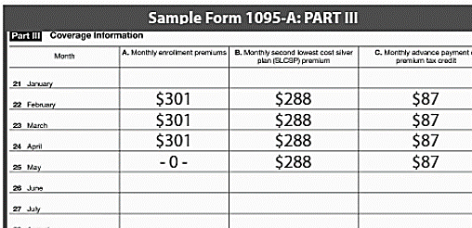
PTC – Premium Not Paid
The premium must be paid by the due date of the return to claim PTC
When taxpayer stops paying, there is one month that 1095-A will show as zero
Notes:
If there is more than one month with column A blank, there is a mistake. Taxpayer should follow up with Mkt to get a corrected 1095-A for their files (and the IRS’s files).

Slide 111
PTC – Premium Not Paid
Taxpayer not eligible for PTC for that month
Taxpayer does have coverage for that month
No exemption is needed

Slide 112
PTC – Premium Not Paid
Taxpayer may be better off paying the premium they are responsible for
PTC repayment may be greater
Need to get a corrected 1095-A
Can file return now; no need to wait

Slide 113
PTC – Multiple Policies
Two or more individuals of the same tax family in the same zip/city are enrolled in different Mkt policies
Can add up the actual cost of their coverage (1095-A column A)
Can add up the reported amount of APTC (1095-A column C)
Cannot add up the SLCSP quotes (1095-A column B)
Notes:
The column A amounts will be for essential health benefits and will be adjusted by the Mkt to include pediatric dental coverage and exclude nonessential benefits, e.g. adult dental
Cannot merely add the SLCSP amounts shown on the 1095-A
Instructor should show how to look up 2016 quotes on Healthcare.gov or the state exchange

Slide 114
PTC – Multiple Policies (cont.)
Need to look up the SLCSP quote using the ages at the beginning of the year
Use fewest number of policies possible
Can add up the SLCSP in some cases (e.g. pre-marriage months)
See Pub 974 or F8962 instructions for more details
Notes:
Cannot merely add the SLCSP amounts shown on the 1095-A
Instructor should show how to look up 2016 quotes on Healthcare.gov or the state exchange

Slide 115
PTC – Multiple Policies (cont.)
When taxpayer moves (particular from one state to another) they will have multiple Marketplace policies
In that case, add the SLCSP amounts from the 1095-A month by month and enter in TaxSlayer (do not need to recompute)
See Pub 974 or F8962 instructions for more details

Slide 116
PTC – Ineligible Individual on Policy
See Pub 974
Form 1095-A may include coverage for an ineligible individual
May need to get new quotes for both the actual plan cost and the SLCSP
Check with site manager whether return will be prepared at your site
Notes:
If APTC was granted with respect to the unlawfully present individual, the entire APTC for that person must be repaid – no cap
Lawfully present coverage family members’ APTC repayment (if any) can be capped

Slide 117
PTC – Ineligible Individual on Policy
See Pub 974
Examples
An unlawfully present dependent on the same policy as a lawfully present taxpayer
An individual that was eligible for government-sponsored coverage but was included in the Marketplace policy for the same month (e.g. Medicare)
Notes:
Usually, PTC cannot be claimed for a month later than the month after government coverage is approved.
If government coverage is granted retroactively, PTC can still be claimed until the month following the coverage determination

Slide 118
PTC – Unclaimed Individual (special situation)
When APTC has been given by the Marketplace for an individual and
That individual does not claim their own exemption deduction and
No one else claims the individual as a dependent, then
The person that enrolled the individual is responsible for reconciling the APTC
Notes:
TP cannot claim PTC for a nondependent
Result is that all APTC will need to be repaid as not a member of the tax family

Slide 119
PTC – Unclaimed Individual Example
Possible situation:
Child lives with three different relatives during the year; each less than 6 months
Most of the child’s support is provided by the state (e.g. public assistance)
No relative can claim the child – not a qualifying child (resided together <6 months) nor qualifying relative (provided <½ of support)
(Continued next slide)

Slide 120
PTC – Unclaimed Individual Example cont.
Possible situation (cont.):
If one of the relatives enrolled the child in a Marketplace policy with APTC, they must reconcile the APTC on their return, even though they cannot claim the child
No PTC allowed for a nondependent
Notes:
Child would likely have been eligible for CHIP and marketplace should have denied APTC, depending on how the questions were answered

Slide 121
Final PTC
Based on final tax return data
Final PTC may be more than the Advance PTC (APTC)
Claim a credit on the 1040
Final PTC may be less than the APTC
Pay back the excess (may be capped)

Slide 122
Repayment of Excess APTC
Pub 4012 Tab H
Cap on repayment is based on Household MAGI* as a % of FPL
Full repayment if ≥ 400% FPL
No rounding of percentages!
*PTC definition
MAGI % of FPL | Single | All others
Less than 200% | $300 | $600
At least 200%, but less than 300% | $775 | $1,550
At least 300%, but less than 400% | $1,300 | $2,600
400% or more | No limit | No limit
Notes:
The 400% is exact; anything less than 400% is not 400%
For example 399.8% is not 400%
Form instructions say to use 401 for anything over 400 on 8962 line 5, so tax form simply show 401 (not the actual % of FPL)

Slide 123
PTC Repayment
No cap on repayment if not lawfully present in the US or electing to take at least one month of Health Coverage Tax Credit on Form 8885 (out of scope)
Be sure to answer NO to this question

Slide 124
PTC – Watch for Cliff Hangers
If it appears the taxpayer is near a benchmark income level, consider possible ways to reduce AGI
Household income is 200%, 300% or 400% of FPL
Consider: deductible IRA (including a recharacterization of a Roth IRA contribution to a traditional IRA)
Notes:
Recharacterization of a Roth conversion is no longer allowed; but taxpayers can recharacterize a contribution from one type of IRA to the other

Slide 125
PTC – Watch for Cliff Hangers (cont.)
Test to see which education benefit is better after entering all return and ACA data
If there is a Schedule C in the return, the self-employed health adjustment to gross income could make a substantial difference
If PTC is involved with Schedule C, return is out of scope
Refer to paid preparer as cost can be significant
Notes:
When health insurance is deductible as an adjustment to gross income, the cost of the coverage is increased or decreased by repayment of excess APTC or additional PTC, respectively
This is an iterative process requiring up to three recalculations – pub 974

Slide 126
PTC – Scholarships / Grants
The student may elect to treat some or all of their grant as taxable income to increase an allowable education credit
When taxable, the grant is considered earned income for the gross income test of filing requirement
Once a filing requirement exists for the student, the student’s MAGI may have an ACA impact on the taxpayer’s return (e.g. parent’s return)
Use Bogart Education calculator to optimize education credit considering ACA implication
Notes:
The test to see which education benefit is better includes the use of scholarships or grants to pay qualified education expenses (the grant is excluded from income) or to pay for other expenses, such as room and board. The latter situation may create a filing requirement for the student and there may be ACA implications.

Slide 127
PTC – MFJ to MFS?
If it appears MFJ taxpayers are having to repay a lot of APTC (e.g. at 450% of FPL)
Consider MFS status
They are no longer eligible for PTC
BUT the repayment cap may apply!
MFS status may also help in the year of marriage instead of the alternative calculation, which is out of scope
Refer to 8962 instructions
Notes:
If both spouses are on a single policy, each is allocated 50% of the APTC (TP cannot elect a different percentage) – see 8962 instructions
Must complete the shared allocation (Part IV) to show only 50% claimed and the SSN of the other spouse
Will need to look up the proper SLCSP if any PTC can be claimed, e.g. one spouse is able to claim HoH or is abused/abandoned
They are not allowed PTC, but the cap can apply to the APTC that must be repaid

Slide 128
PTC and Medical Itemized Deduction
The itemized deduction for medical insurance in 2018 is
Decreased for any additional PTC that is claimed on the 2018 return
Increased for any excess APTC that must be paid back with the 2018 return
Notes:
This is an exception to the normal cash basis reporting rules – see 8962 and Sch A instructions

Slide 129
PTC and Medical Itemized Deduction
For a return with PTC and itemizing medical deductions, go to Schedule A
Make an “other medical” entry
Positive amount for excess PTC that is being repaid on the return (increases the current deduction)
Negative amount for additional PTC on the return (reduces the current deduction)
Make a note on the intake form for taxpayer and reviewer

Slide 130
PTC Quiz 1
Roger's APTC is $2,400. He is single with no dependents, and lives in Mississippi. His household income is over 400% of the FPL for a family size of one. How much of his APTC will he have to repay with his tax return?
A $0
B $1,000
C $1,400
D $2,400

Slide 131
PTC Quiz 1
Answer: D
Because Roger's household income is over the 400% FPL, his additional tax liability is not capped by the additional tax limitation table

Slide 132
PTC Quiz 2
Judy is single with no dependents
In December 2017, Judy enrolled through the Marketplace in a qualified health plan for 2018
On July 14, 2018, Judy enlisted in the Army and was immediately eligible for government sponsored minimum essential coverage
For what period is Judy able to claim a premium tax credit (if she meets all of the eligibility criteria)?

Slide 133
PTC Quiz 2 (cont.)
A - The entire year
B - January through June
C - January through July
D - Judy is not eligible for the premium tax credit
Judy is eligible for PTC for July assuming she paid her premium for July (and did not get a full premium refund) because her government-sponsored coverage was not in effect on July 1
Notes:
Judy would ineligible for PTC starting with the first full month of government coverage, August – Pub 4491, p. 3-11 TIP
If Judy got a partial month refund for July, would still be eligible for PTC since she is eligible on July 1

Slide 134
PTC Quiz 3
Piper’s income is 300% of the FPL for her family size. For this tax year, she purchased health insurance through her employer. Is she eligible to take the premium tax credit for herself?
No – the coverage must have been purchased through the Marketplace to claim PTC

Slide 135
PTC Quiz 4
Patrick is single and has no dependents
In November 2017, Patrick estimated his 2018 household income to be $27,825 and he enrolled in a Marketplace qualified health plan
The Marketplace determined he was eligible for advance payments of the premium tax credit, but he decided to claim the credit on the return
Patrick began a new job in August 2018 and became eligible for affordable employer-sponsored coverage on September 1st
Is Patrick eligible for the premium tax credit?

Slide 136
PTC Quiz 4 (cont.)
Answer: Since Patrick became eligible for affordable employer-sponsored coverage for the full month of September, he is eligible for a premium tax credit from January through August of 2018* only (if otherwise eligible)
* See instructions if income falls below 100% FPL

Slide 137
PTC Quiz 5
Harry purchased insurance through the Marketplace. What documentation will he receive to prepare his tax return?
He will receive Form 1095-A

Slide 138
PTC Quiz
Changes in circumstances that can affect the amount of the premium tax credit include:
A. Decrease in household income
B. Marriage
C. Birth of a child
D. Losing employer-sponsored health care coverage and buying Marketplace coverage
E. All of the above

Slide 139
ACA Scope Limitations

Slide 140
ACA – Scope Limitations
Pub 4012 Tab H
Form 8962, Part IV: Shared policies
A Marketplace policy that covers individuals that are not on the same tax return
Examples:
A recently divorced couple on one marketplace policy
Child covered in a marketplace policy with one divorced parent but claimed by the other
Child covered on parent’s marketplace policy moves out and claims own exemption

Slide 141
ACA – Scope Limitations
Form 8962, Part V: Alternative Calculation for Year of Marriage
See 5 questions in Pub 4012, tab H
Applies only when there is a Marketplace policy(ies) and there is excess APTC*
If tentative 8962 shows additional PTC, alternative calculation does not apply and return is in scope*
*8962 instructions worksheet 3
Notes:
Example: separately, one or the other was eligible for PTC but together are over 400% FPL.

Slide 142
ACA – Scope Limitations
Self-employed individual’s health insurance adjustment to gross income is in scope for 2018
Greatly complicated if PTC is involved
Out of scope when PTC is involved

Slide 143
Quality Review

Slide 144
Quality Review
Months of coverage or exemptions on the return match months of coverage or exemptions on intake sheet?
Notes:
When it appears SRP will apply, the return should be reviewed by a “Master” in ACA
Apprentice Counselors may wish to refer the return to a more experienced preparer

Slide 145
Quality Review: SRP and Exemptions
When Form 8965 is required, does it show all exemptions used?
All possible exemptions have been considered
Might a hardship exemption apply – can now be claimed on the return

Slide 146
Quality Review: Premium Tax Credit
Form 8962 shows correct PTC?
MAGI of claimed dependents whose income exceeds their filing threshold have been included in ACA calculations?
If MFS with domestic violence exception, is box on Form 8962 marked?
If itemizing medical, insurance premiums were adjusted for excess or additional PTC?

Slide 147
Quality Review
If income-based SRP or significant repayment of APTC is shown, have alternatives to reduce AGI (or AGI of claimed dependents) been considered?
Notes:
When it appears SRP will apply, the return should be reviewed by a “Master” in ACA
Apprentice Counselors may wish to refer the return to a more experienced preparer

Slide 148
Affordable Care Act

